Slide 1
IPL T20(2008–2024) Data Analysis Project
Done by
Divakar S
Date : 7/12/2024

Slide 2
Project Overview
In this project, is to analyze IPL T20 data from 2008 to 2024 to uncover key trends and performance insights.
Objectives :
Identify top players and teams across seasons.
Analyze match outcomes and patterns.
Use data-driven insights to explore trends like run rates, wicket-taking efficiency, and toss impacts.
Tools: Power BI for visualization, Excel/SQL for data preprocessing and analysis.

Slide 3
Data Sources and Methodology
Dataset Name: IPL Dataset from 2008 to 2024
Author : Prateek Bhardwaj
Source : Kaggle website.
Methodology :
Data Collection: Gathered Dataset from Kaggle Website.
Data Cleaning: Use Excel or SQL for preprocessing (handling missing values, normalizing data).
Analysis: Use Power BI for creating interactive dashboards and visualizing key trends (player stats, team wins, etc.).

Slide 4
Tools and Features
Excel/SQL: Data cleaning, filtering, and analysis for preprocessing large datasets, calculating key metrics like strike rates, economy rates, and match averages.
Power BI: Interactive dashboards, drill-down capabilities, visualizations of player and team performance over time.
Kaggle IPL Dataset: Source of the raw data.
Python (optional): For any advanced data cleaning and preprocessing tasks.
Features:
Yearly and team-wise comparisons.
Player performance tracking.
Predictive insights for future seasons based on historical data.

Slide 5
Dataset Information
The dataset includes IPL match data from 2008 to 2024, covering:
Match details: Dates, venues, teams, results (winner, margin of victory).
Player statistics: Runs, wickets, strike rates, economy rates, etc.
Team performance: Wins, losses, net run rate.
Additional data: Toss results, player of the match, and venue performance
Data Structure:
Format: CSV File
Key Fields: Examples of columns includes match ID, team names, player names, runs scored, wickets taken, and match outcomes.

Slide 6
Player Performance Analysis
Top Batsmen by Total Runs:
Virat Kohli, David Warner, AB de Villiers, Shane Watson consistently featured in the top run-scorers list.
Top Bowlers by Wickets Taken:
Lasith Malinga, Dwayne Bravo, Sunil Narine, Jasprit Bumrah dominated with wicket-taking abilities.
Strike Rates and Economy Rates:
Key metrics like strike rate (for batsmen) and economy rate (for bowlers) played a significant role in assessing performance across the years.

Slide 7
Match Outcomes & Toss Analysis
Match Outcomes:
Team Winning on basis of wickets and Runs.
Toss Decisions influenced win percentages.
Teams Who choose Field first had a higher winning percentage historically.
Insights:
Batting first and second based on the condition.
Toss heavily impact on Strategic decisions.

Slide 8
Venue Analysis
Top IPL venues by Runs Scored:
Wankhede Stadium (Mumbai) and M Chinnaswamy Stadium (Bangalore) featured has high scoring venues.
Eden Gardens , MA Chidambaram Stadium and Feroz Shah Kotla Stadium were the stadiums are key contributes to the wickets and runs.
Venue Impact on Team Performances:
Venues like Wankhede and M Chinnaswamy stadium were known for high Scoring matches.
Feroz Shah Kotla and Rajiv Gandhi International Stadium often had a low Scoring Matches dur to pitch condition.

Slide 9
Team Performances and Winning Percentages
Teams with Most Wins:
Mumbai Indians and Chennai Super Kings emerged as the most successful teams ,and consistently topping the Points table.
Winning Percentages:
Mumbai Indians: High Win Percentages(Especially in playoff matches).
Chennai Super Kings: Consistent high performance , making frequent appearance in finals.
Team Insights:
Royal Challengers Bangalore and Delhi Capitals had inconsistent performance despite strong batiing lineups.
Teams like Kolkata Knight Riders and Sunrises Hyderabad has notable combacks in IPL.

Slide 10
Player Milestones:
Man of Match Awards:
Players like AB de Villiers , Rohit Sharma , David Warner , Chris Gayle consistently dominated the “Man of Match” category
Record Breaking Performance:
Highest Individual Scores.
Most Sixes and boundries in one season.
Best bowling figures in a ipl Matches.
Most Sixes scored by a batsman.
Most stumpings by a Wicket-keeper.
Most Catches taken by a player as a fielder.

Slide 11
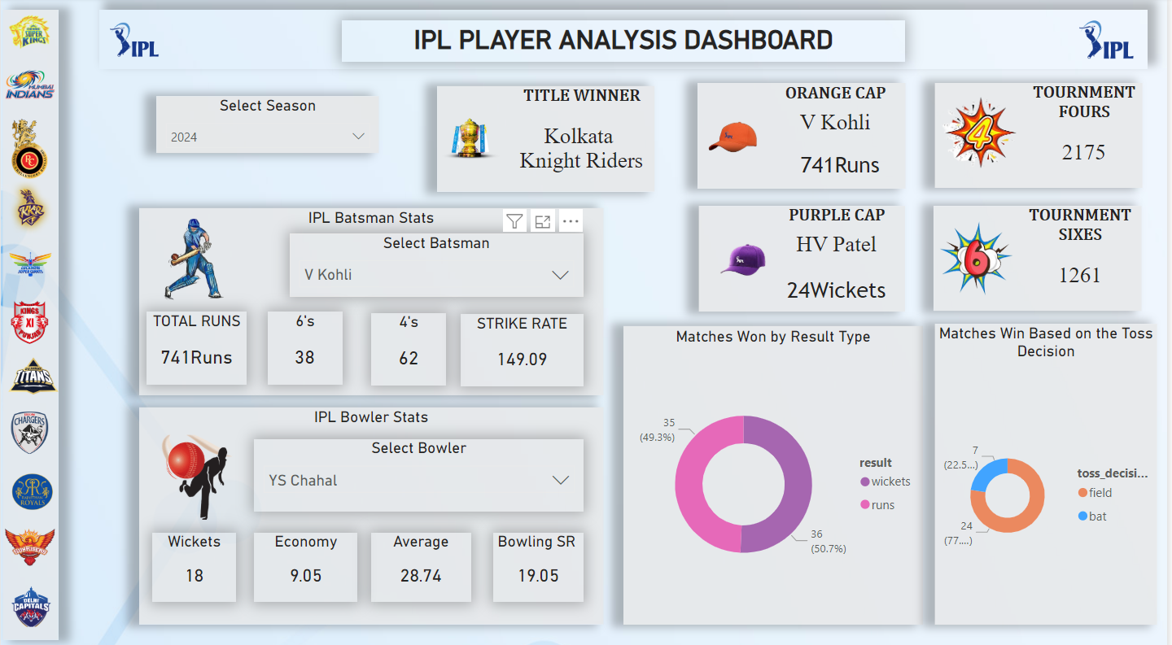
Dashboard :
In This Dashboard ,It shows about the :
Title Winner of each season.
Orange Cap and Purple Cap winner for the highest run scorer scored by the batsman and most wickets taken by the bowler.
Tournment Sixes and fours.
Matches won based on the Toss decisions.
Individual Batting and bowling performance.

Slide 12
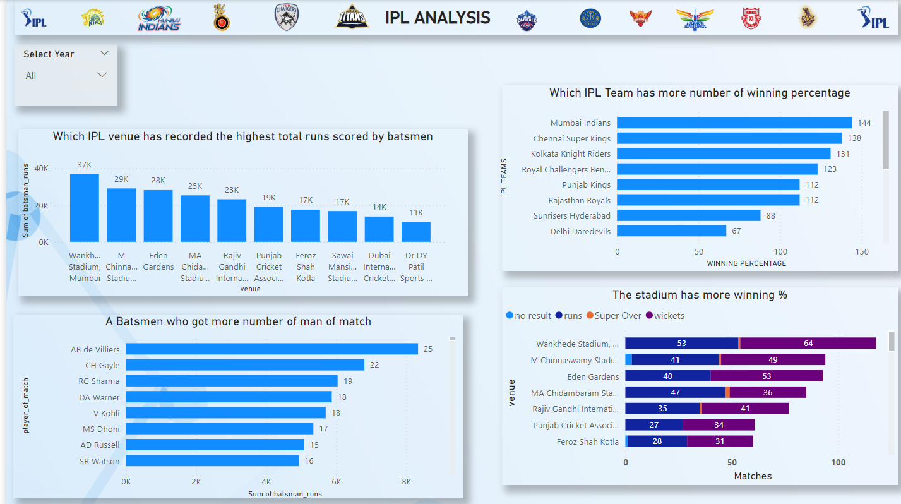
Dashboard (Contd.,)
In This Dashboard, it shows about the :
Which IPL venue has recorded the highest no of runs scored by batsmen.
Maximum no of winning Percentage by an IPL teams.
The more no of Man of Match got by a batsmen.
In which stadium has more Winning percentage.

Slide 13
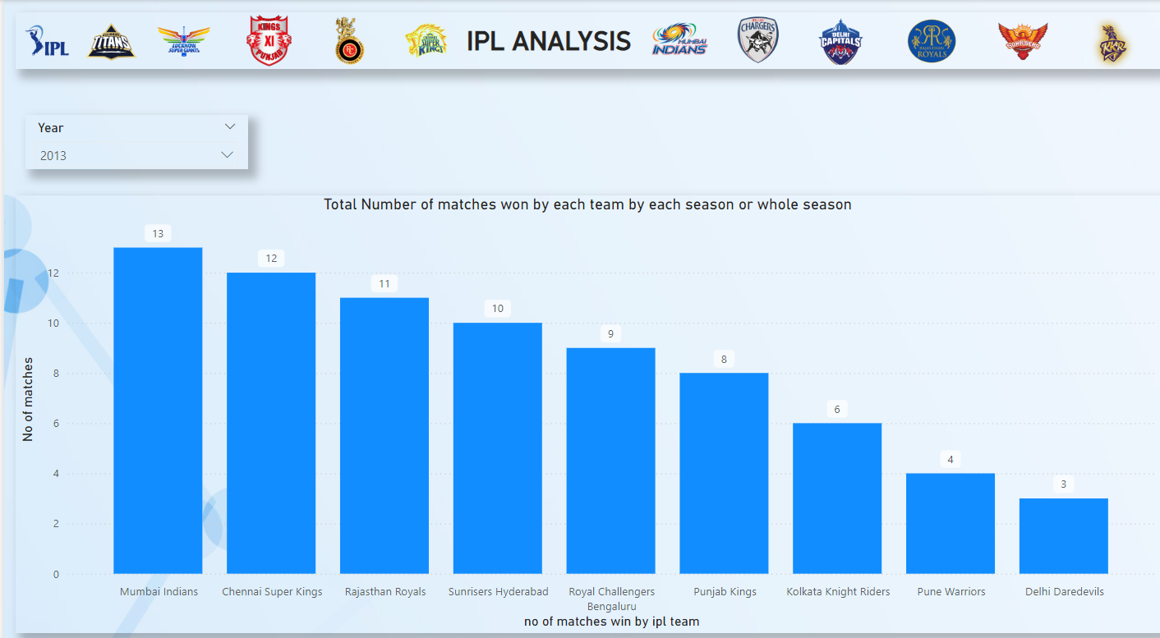
Dashboard (Contd.,)
In this Dashboard, it shows about the:
Total number of matches won by a each IPL teams by each season or Whole season.

Slide 14
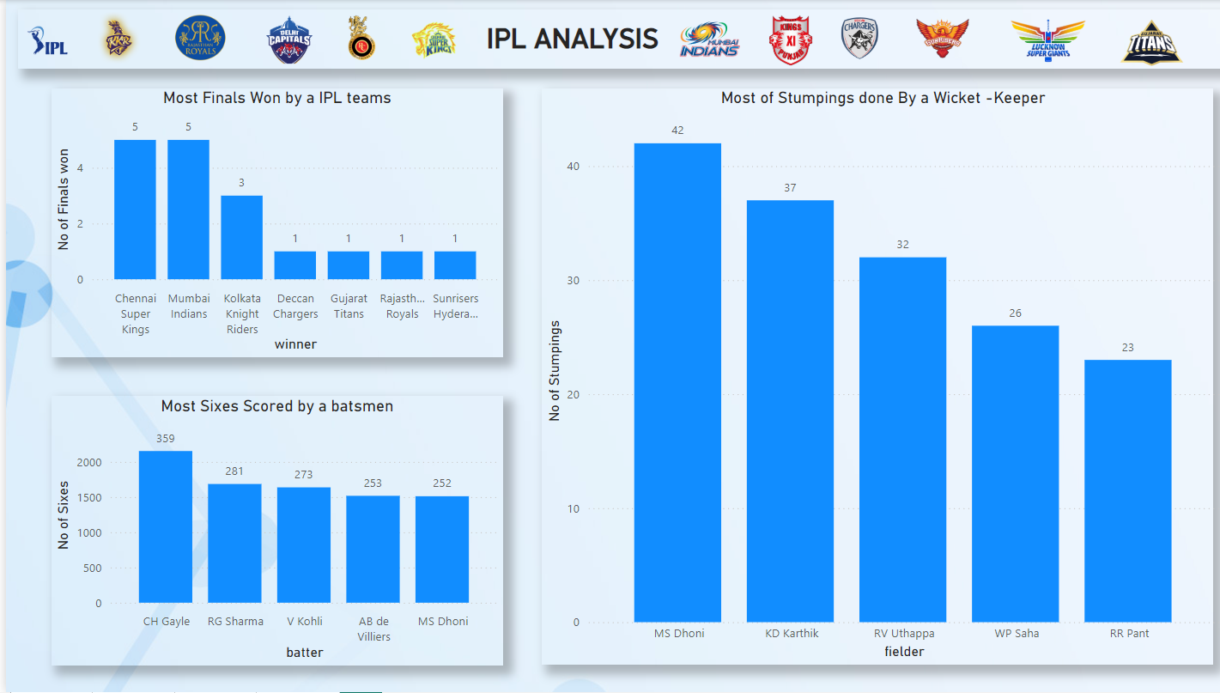
Dashboard (Contd.,)
In this Dashboard , it shows about the:
Most Finals won by the IPL teams in 17 years.
Most no of sixes scored by the batsmen in whole IPL tournament.
Most no of Stumpings done by the wicket-keeper.

Slide 15
Key Insights & Future Scope:
Key Insights:
Mumbai Indians and Chennai Super Kings have set the benchmark for consistent team
performance.
The importance of toss decisions in shaping match outcomes.
Top batsmen and bowlers who have made their mark of the IPL tournament’s history.
Future Scope:
The potential for predictive analysis to forecast match results based on historical or previous data.
Enhancing fan engagement through real – time performance dashboards.

Slide 16
Conclusion:
The analysis of IPL seasons from 2008 to 2024 reveals:
Team Success: Mumbai Indians and Chennai Super Kings dominated with consistent performances, while teams like KKR and Gujarat Titans had standout seasons.
Player Excellence: Stars like Virat Kohli, David Warner, Chris Gayle, and Lasith Malinga delivered record-breaking performances, shaping IPL’s legacy.
Venue Insights: Stadiums like Wankhede and Chinnaswamy influenced match outcomes, with toss decisions and pitch conditions playing critical roles.
Evolving Trends: Increased boundaries, strike rates, and innovative bowling highlight IPL's growing competitiveness.
Overall, IPL’s journey showcases thrilling performances, strategic evolution, and its global impact on cricket.

Slide 17


